Slide 2
TEAM NOOBS
AKASH RANJAN(CAPTAIN)
HARSH PATEL
AYUSH BHARGAVA
PRASHANT UPADHYAY
THEME DOMAIN - HEALTHCARE
*WORKING PROTOTYPE IS ATTACHED IN GITHUB REPOSITRY

Slide 3
PROBLEM STATEMENT
Due to COVID-19, a huge number in people of our country are on the streets, now with no food and shelter. How can you use technology to help the authorities solve this problem ?
The statement raises our concern on the biggest issue in our country that is the inavailability of food and shelter due to lockdown in order to protect people from COVID - 19.
The problem statement basically raises a question in our mind that how with the help of technology we can help the authority in providing proper food and shelter to the people who are in need or we can say to the people who had lost there jobs and have nothing to eat.

Slide 4
SOLUTION
Our target is to provide food and shelter to the people in need.
Our target is not only to provide food and shelter facilities but also search people who are in need because arranging the sources is not enough until we don't have the consumers to consume it.
Our team has decided to make an app named SHRAM SEVA .
This app can also be accesed by our government officals for example policemen,health workers,mininsters,mla's,etc.But that is not enough because only government officals cannot do that all alone , so there will a a group of volunteers (the people who are interested can only join) who will help government officals, they will be provided with proper sanitizing facilities.
Every user means volunteer and government officals will have there personal accounts (they will asked to create account by providing necessary details) in which they will have various sections like update (regular updates like nearby area empty for shelter information, the number of people rescued,etc) , map ( map will locate the nearby shelter and food facilities available).
Our next and most imortant Section in our App is to find space. So, for this our app has a separate section in which Host can create and access Host user's account for adding there properties for rent to the government where these people in need can be shifted and government will pay the Host accordingly . This information will be directly transmitted to our authority for further instance.

Slide 5
Our target is to provide our food and shelter facilities to maximum number of people. So, our first target is to search for contracters,factory owners,mill owner,etc because, they have the maximum data regarding the workers who are actually in need.
Secondly the most important thing is the advertisment of the app , so that more and more number of people will be able to connect with our food and shelter facilities chain.
This is not enough some people will still have no access to our food and shelter facilities (vegetable sellers,maids,daily wage workers) so here in this case police will play a very important role, they will search and create awareness among people. They will provide phone number to the local people if incase they find a group of people in need of food and shelter facilities can directly inform through that number.
Our task is not yet done, there are many more who are living far away from there family just to get a proper living to him and his family . Due to lockdown they lost there jobs. Due to inavailability of jobs they started moving to there natives in order to get food and shelter facilities. So, now our app users(basically policemen) will be present at every checkpost and will be able to rescue the people who are passing through these areas.
Our app has separate section to store the data of these people so that if there family searches them or when the lockdown reopens they can be easily be transferred to there native towns,village.
Our volunteers will teach them the benefits of social distancing, good santizing,etc.
Our app will have a separate section for funding and donations with complete transparency.

Slide 6
KEY ASPECTS OF OUR SOLUTION
Beneficiary/User segment this solution is intended for
This solution is intended for the government officals like policemen,mla's,minister,volunteers.
How it helps the beneficiary/user segment
It will make the work of authority very easy to manage the people who need food and shelter facilities. Now, the authority can directly control everything with this app with less hindrance.
Imapct the solution will create
According to me this is one of the best solution because as we all know to maintain proper lockdown we except that each and everyone should get proper food and shelter and must stay home. A lockdown is violated when poor are not able to get proper food and shelter facilities .No one like to die due to hunger . One of the worker spoked that we are ready to die by COVID - 19 but not due to hunger. If proper food and shelter will be provided then according to me 90% of the battle against COVID -19 is won.

Slide 7
Frame works/Technologies to be use
We are using app development which according to me is the most easiest way to access data, because everyone is having smartphone now a days ( I am not talking about poor people this is for the people who will use this app like the host of the properties,authority,government officials) by which they can easily communicate and locate the locations of shelter and food facilities.
Reason behind this technology
App is the most easiest way to communicate because it doesnot need to type again and again login id and password for logging into the account usually what we do in web pages. Can be easily downloaded and can be used with minimum restrictions.
Effectiveness of the solution in solving the problem and ease of implementation
for making the app more effective every app user will update us regularily by providing us important details (these number of people got resuced or we need some more food or employees are not working properly,etc).
Every volunters will be provided with proper sanitizing facilities .
Separate funding and donation section will be there for providing complete transperancy so that people who are donating should not have trust issues.
Regular sanitizing of shelter will be there ,food will be cooked with proper hygiene and volunteers will be tested regularily .

Slide 8
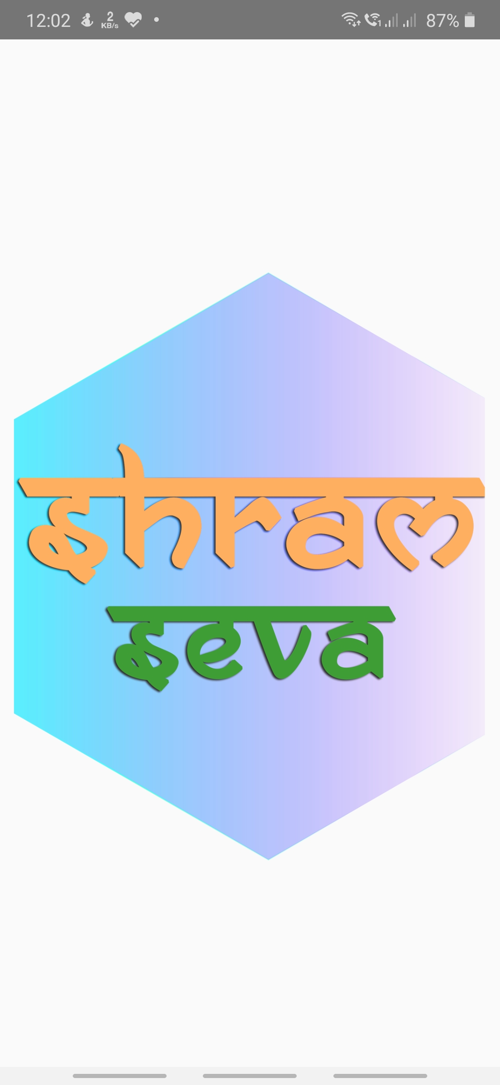
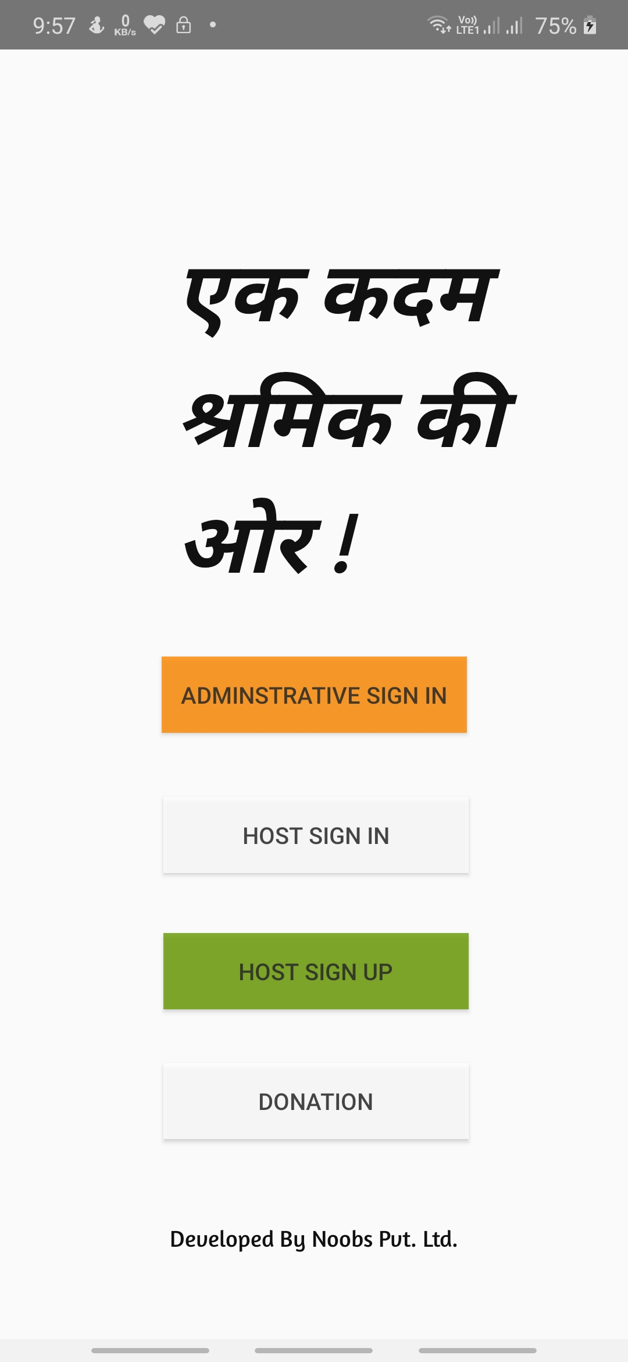
ARCHITECTURE DIAGRAM
THIS IS FOR THE GOVERNMENT OFFICALS AND VOLUNTEERS
THIS IS FOR THE PEOPLE WHO HAD ALREADY REGISTERED THEIR ACCOUNT THROUGH HOST SIGNUP
THIS IS HOST SIGNUP FOR INTERESTED PEOPLE IN GIVING THEIR PROPERTY FOR FOOD AND SHELTER FACILITIES
THIS IS FOR THE DONATION PAGE
AFTER CLICKING APP WE WILL GET THIS LOGO AND APP NAME

Slide 9
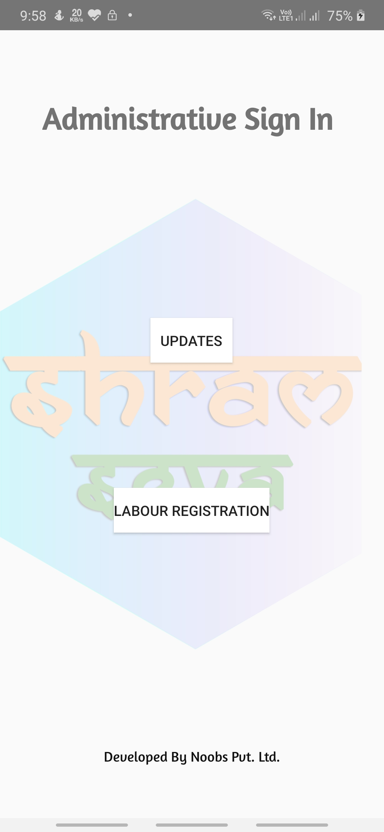
AFTER SUCCESSFULLY SIGN IN THE ADMINISTRATIVE SIGN IN WE WILL GET TWO BUTTONS
1. UPDATES - USED BY OUR ADMINSTARTIVE FOR REGULAR UPDATES
2.LABOUR REGISTRATION - THIS IS USED FOR THE PEOPLE WHO ARE RESCUED BY THEM BY PROVIDING FOOD AND SHELTER FACILITIES IN ORDER TO SAVE IT FOR LATER USE

Slide 10
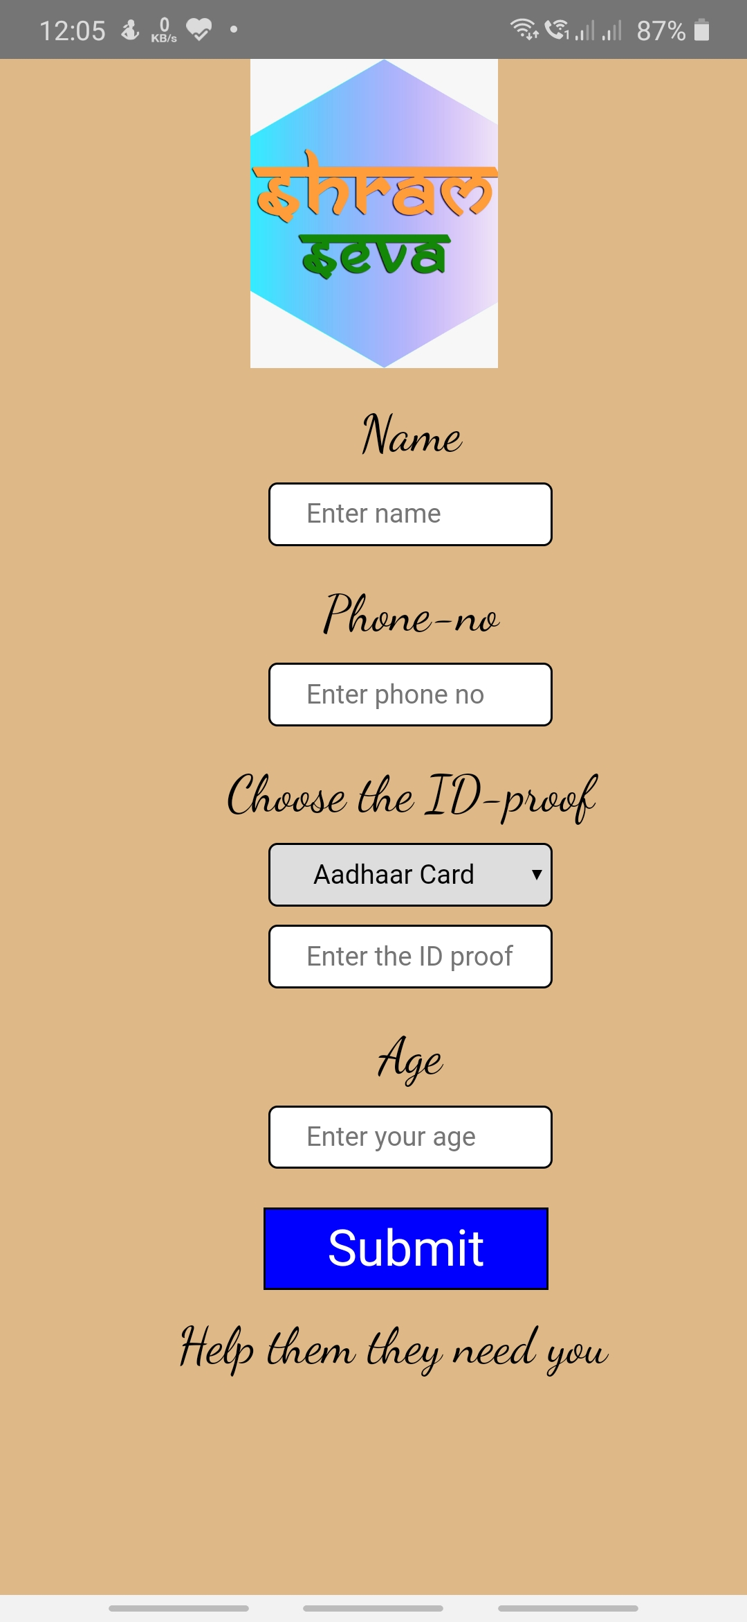
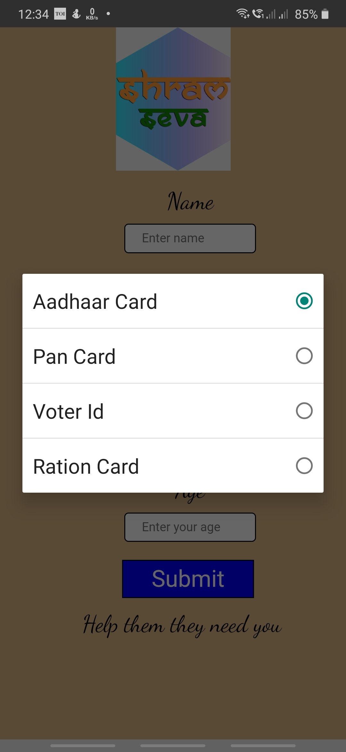
THIS PAGE IS FOR STORING THE DATA OF THE PEOPLE WHO ARE RESCUED BY ADMINISTRATORS UNDER THE ADMINISTRATIVE SIGN IN
HERE WE ENTER THE NAME
HERE WE ENTER THE PHONE NO.
HERE WE CHOOSE THE TYPE OF ID
HERE WE ENTER THE ID NUMBER
HERE WE ENTER THE AGE
BY CLICKING ON SUBMIT BUTTON DATA GETS SAVED IN THE DATABASE
WE HAVE FOUR TYPES OF ID SELECTION

Slide 11
THIS IS THE PAGE FOR UPDATES WHICH CAN ONLY BE ACCESSED BY OUR ADMINISTRATORS UNDER THE ADMINISTRATIVE SIGN IN
THIS WILL CONTINUOSILY SHOW US THE UPDATED DATA OF THE EVENTS TAKING PLACE THROUGH OUR GOVERNMENT OFFICALS
IT HAS THREE SECTION OF TAB BUTTON FOR TYPE OF UPDATE
1. CONTACT FOR OFFICALS- ONLY OFFICALS CAN ACCESS IT FOR CONTACTING US AND CAN ALSO GIVE US THE LATEST UPDATE HERE.
2.CONTACT FOR VOLUNTEERS- ONLY VOLUNTEERS CAN ACCESS FOR CONTACTING AND UPDATING THE LATEST INFORMATION
3.EMERGENCY UPDATES- THIS IS ONLY FOR EMERGENCY PURPOSE FOR BOTH THE GOVERNMENT OFFICALS AND VOLUNTEERS IF THERE ANY ISSUE ARRISES

Slide 12
THIS TEXT AREA IS FOR WRITING THE UPDATES
BY CLICKING THE PLUS BUTTON THE UPDATE WILL BE SAVED AND WILL BE DISPLAYED IN THE BREAKING NEWS PAGE.
HERE ALSO WE HAVE THE 3 SECTION JUST SAME AS BREAKING NEWS PAGE

Slide 13
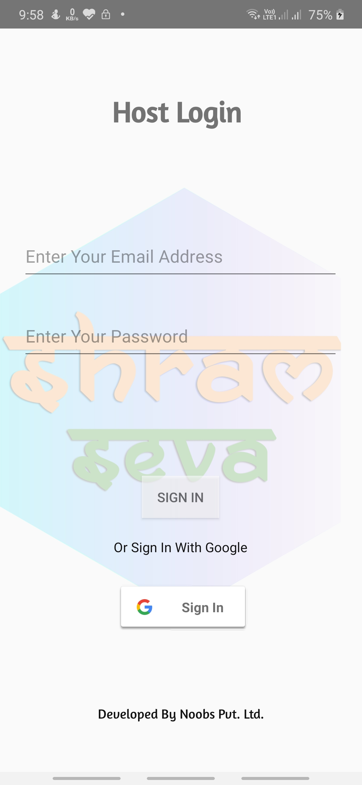
AFTER CLICKING THE HOST SIGN IN THIS WILL APPEAR THIS IS FOR THE PEOPLE WHO ARE INTERESTED IN GIVING THEIR PLOTS,FLATS,ETC AT A REASONABLE PRICE.
HOST LOGIN ID WHO HAD REGISTERED THEIR ACCOUNT IN HOST SIGN UP
HOST LOGIN PASSWORD
BY CLICKING SIGN IN BUTTON ACCOUNT OF THE HOST WILL APPEAR FOR ADDING PROPERTY DETAILS
HOST CAN ALSO REGISTER THROUGH THEIR GOOGLE ACCOUNTS

Slide 14
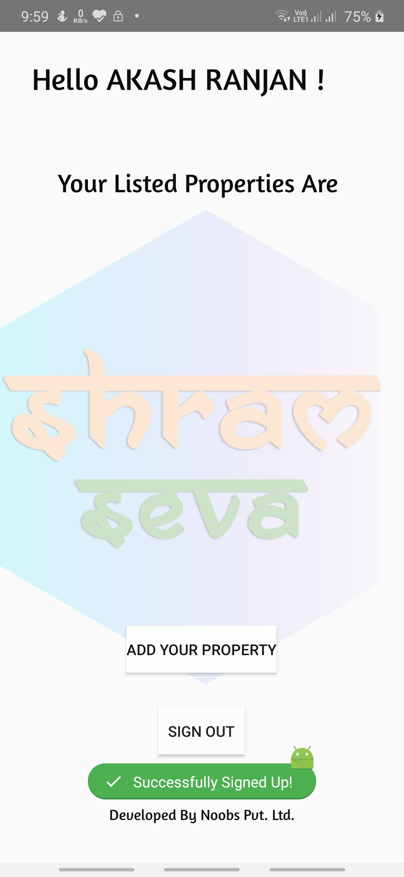
THIS PAGE WILL APPEAR AFTER SUCCESSFULLY SIGN IN USING HOST SIGN IN
IT WILL DISPLAY THE NAME OF THE HOST
AND THE LISTED PROPERTIES IN THE ACCOUNT
THIS IS FOR ADDING NEW PROPERTY BY THE HOST
BY CLICKING ON THE SIGN OUT THE HOST CAN SUCCESSFULLY SIGNOUT THROUGH THE APP

Slide 15
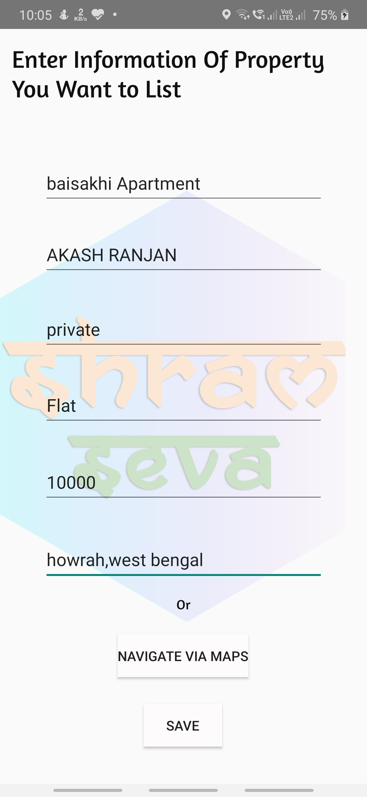
BY CLICKING ADD PROPERTY A FORM WILL APPEAR
HERE HOST WILL ENTER THE AREA NAME OR SOCIETY NAME
HERE HOST WILL ENTER THE OWNER NAME
HERE HOST WILL ENTER TYPE OF PROPERTY ( GOVERNMENT OR PRIVATE )
HERE HOST WILL ENTER THE TYPE OF PROPERTY(FLAT/PLOT/SCHOOL/ETC)
HERE THE HOST WILL ENTER THE THE REASONABLE PRICE OF HIS/HER PROPERTY
HERE THE HOST WILL ENTER THE AREA LOCATION BY TYPING OR BY NAVIGATING THROUGH MAP
HERE THE HOST WILL NAVIGATE TO MAP FOR LOCATING THE PROPERTY
BY CLICKING THE SAVE BUTTON PROPERTY WILL BE SAVED

Slide 16
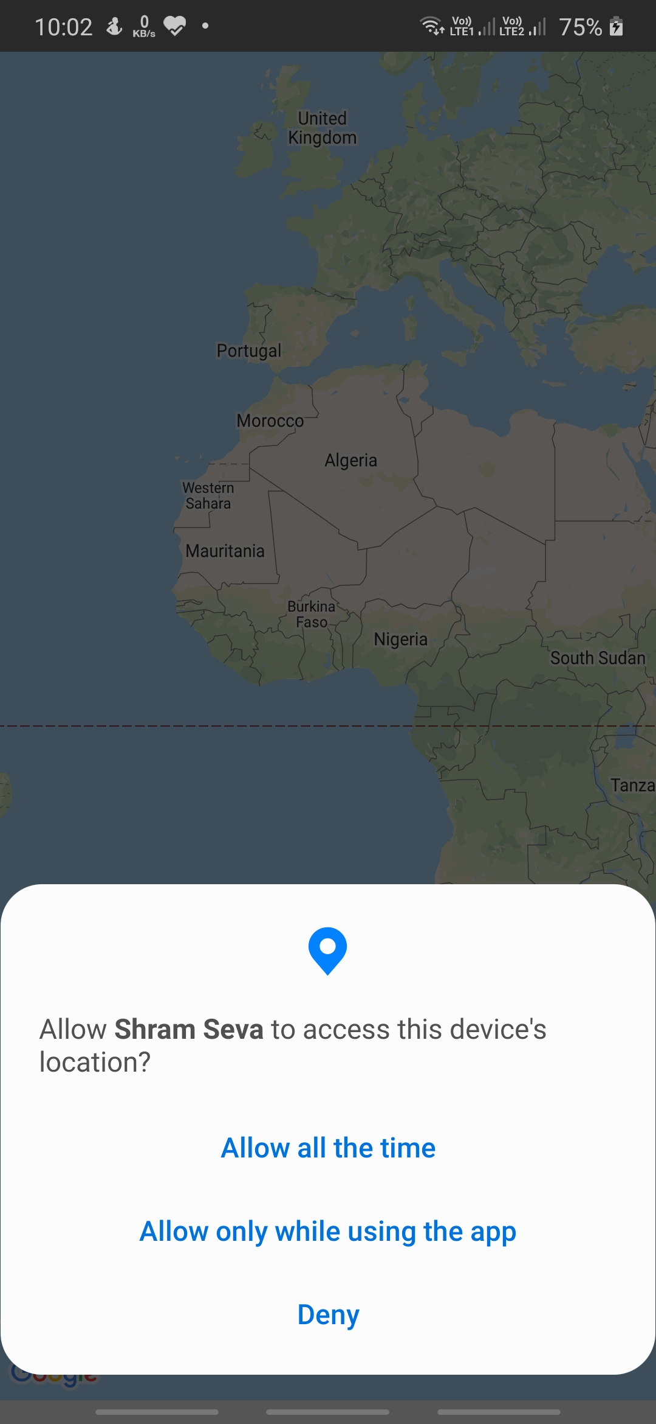
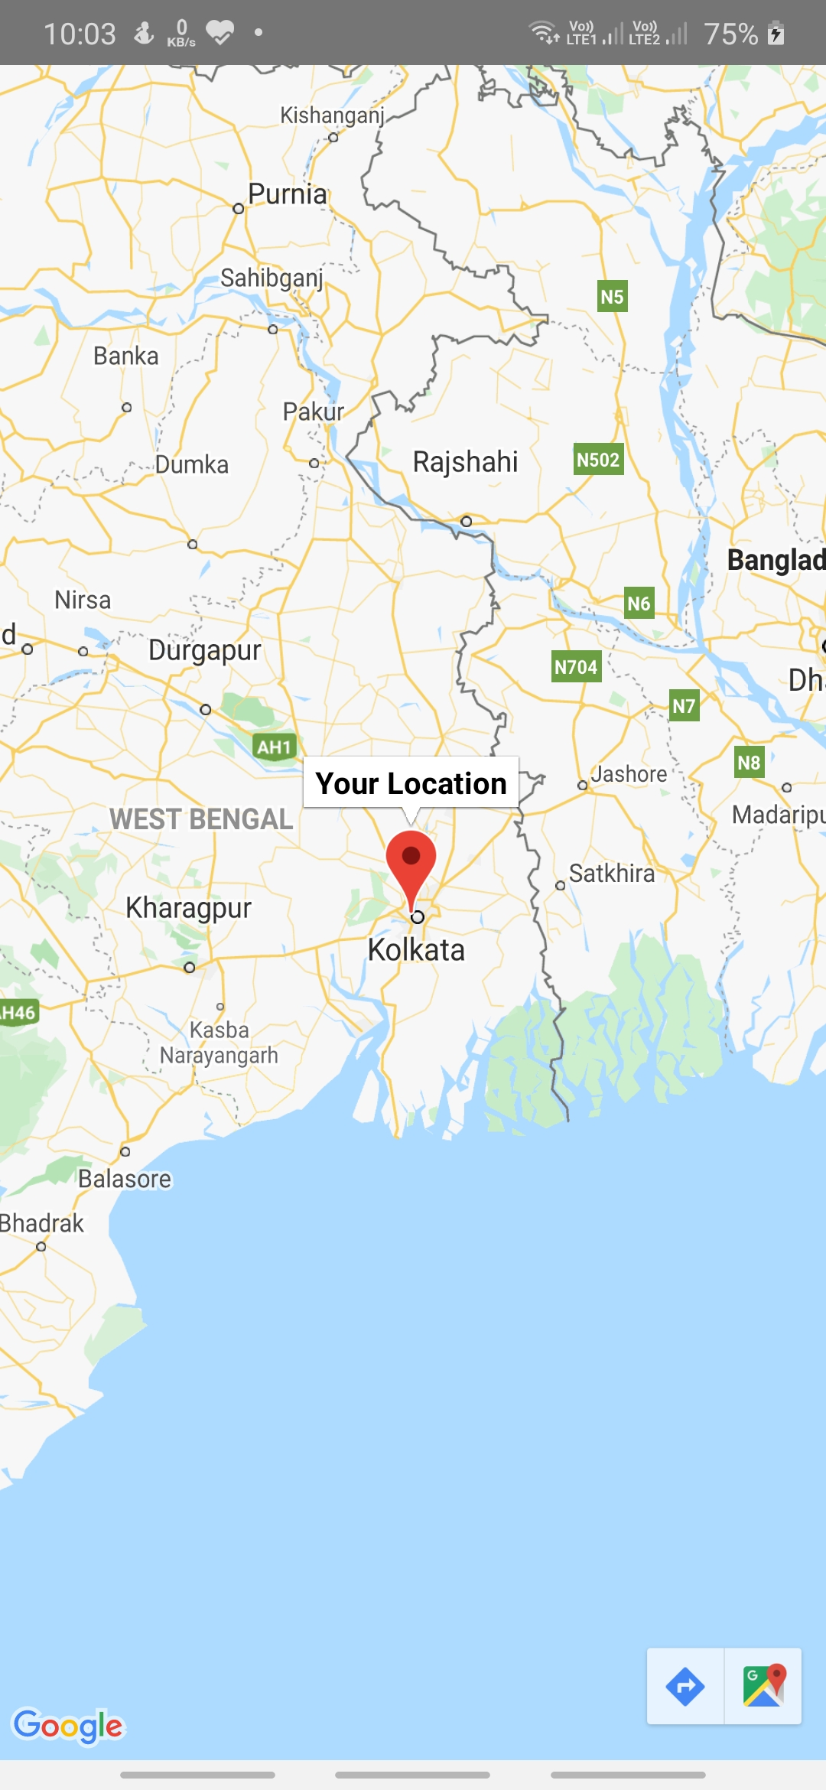
BY CLICKING ON NAVIGATE VIA MAPS THIS WILL APPEAR AND BY ALLOWING APP TO ACCESS LOCATION .
THE LOCATION WILL APPEAR ON MAP BY TITLE YOUR LOCATION BY LONG PRESSING THE MAP LOCATION IT WILL AUTOMATICALLY ADDED TO THE LOCATION OF ADD PROPERTY FORM.

Slide 17
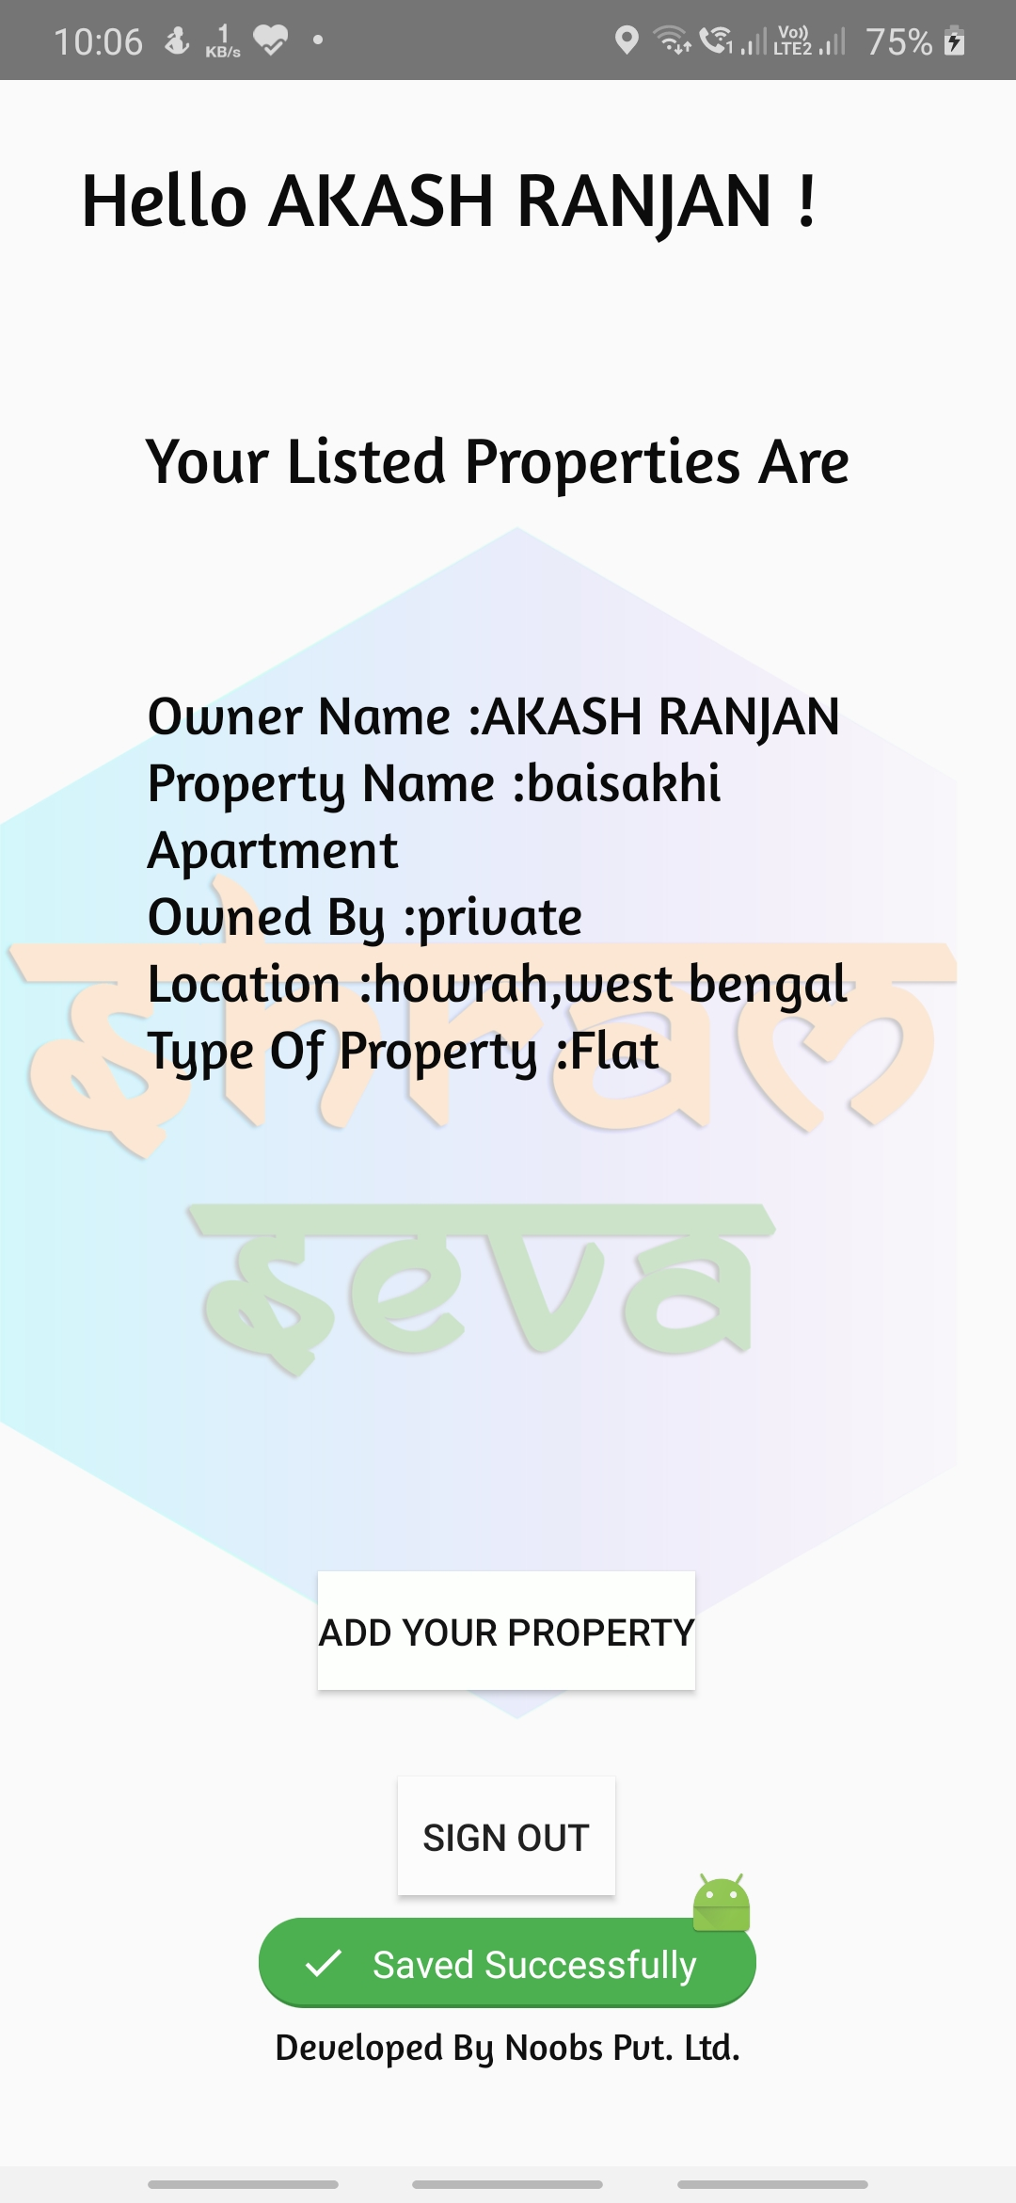
BY CLICKING SAVE BUTTON IN ADD PROPERTY FORM THE PROPERTY DETAILS OF THE HOST WILL BE DISPLAYED
Limit It Restriced to 1 Property/per Host User
ie.From a Single Account a Single Property Can be Listed Over
here.
HOST CAN ADD A PROPERTY
HOST CAN SUCCESSFULLY SIGNOUT BY CLICKING SIGN OUT

Slide 18
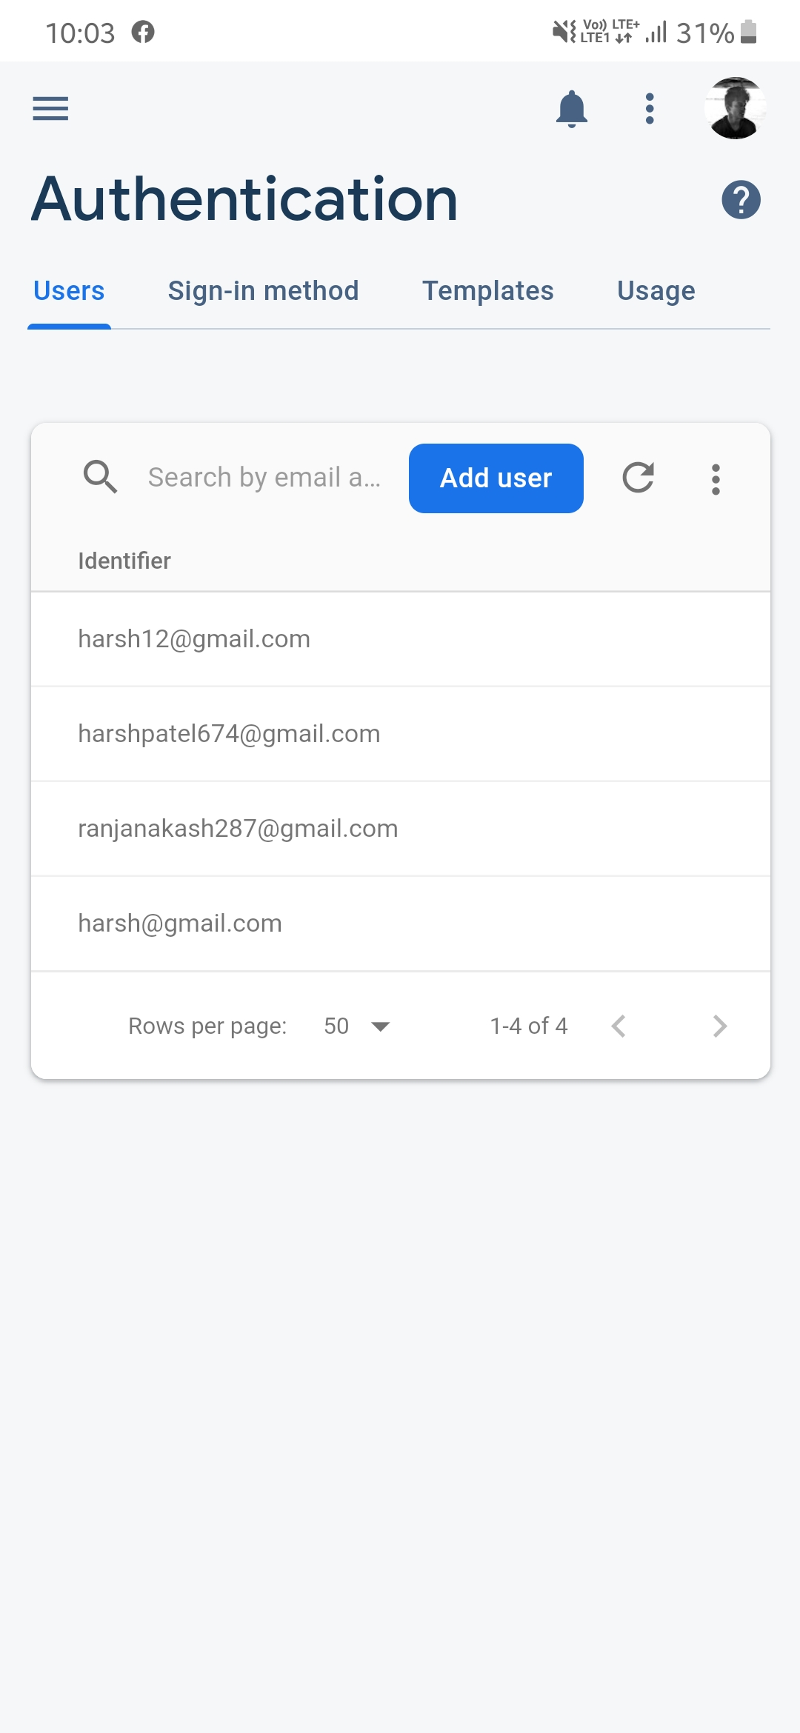
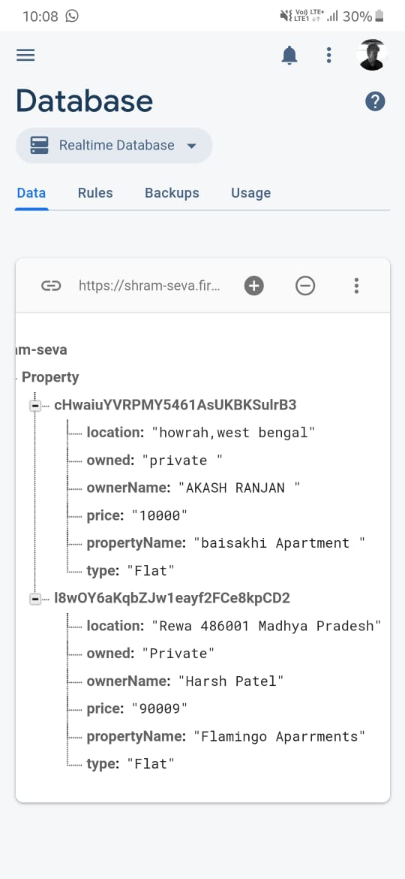
DATABASE OF THE PROPERTY SAVED
AUTHENICATION OF THE EMAILS REGISTERED

Slide 19
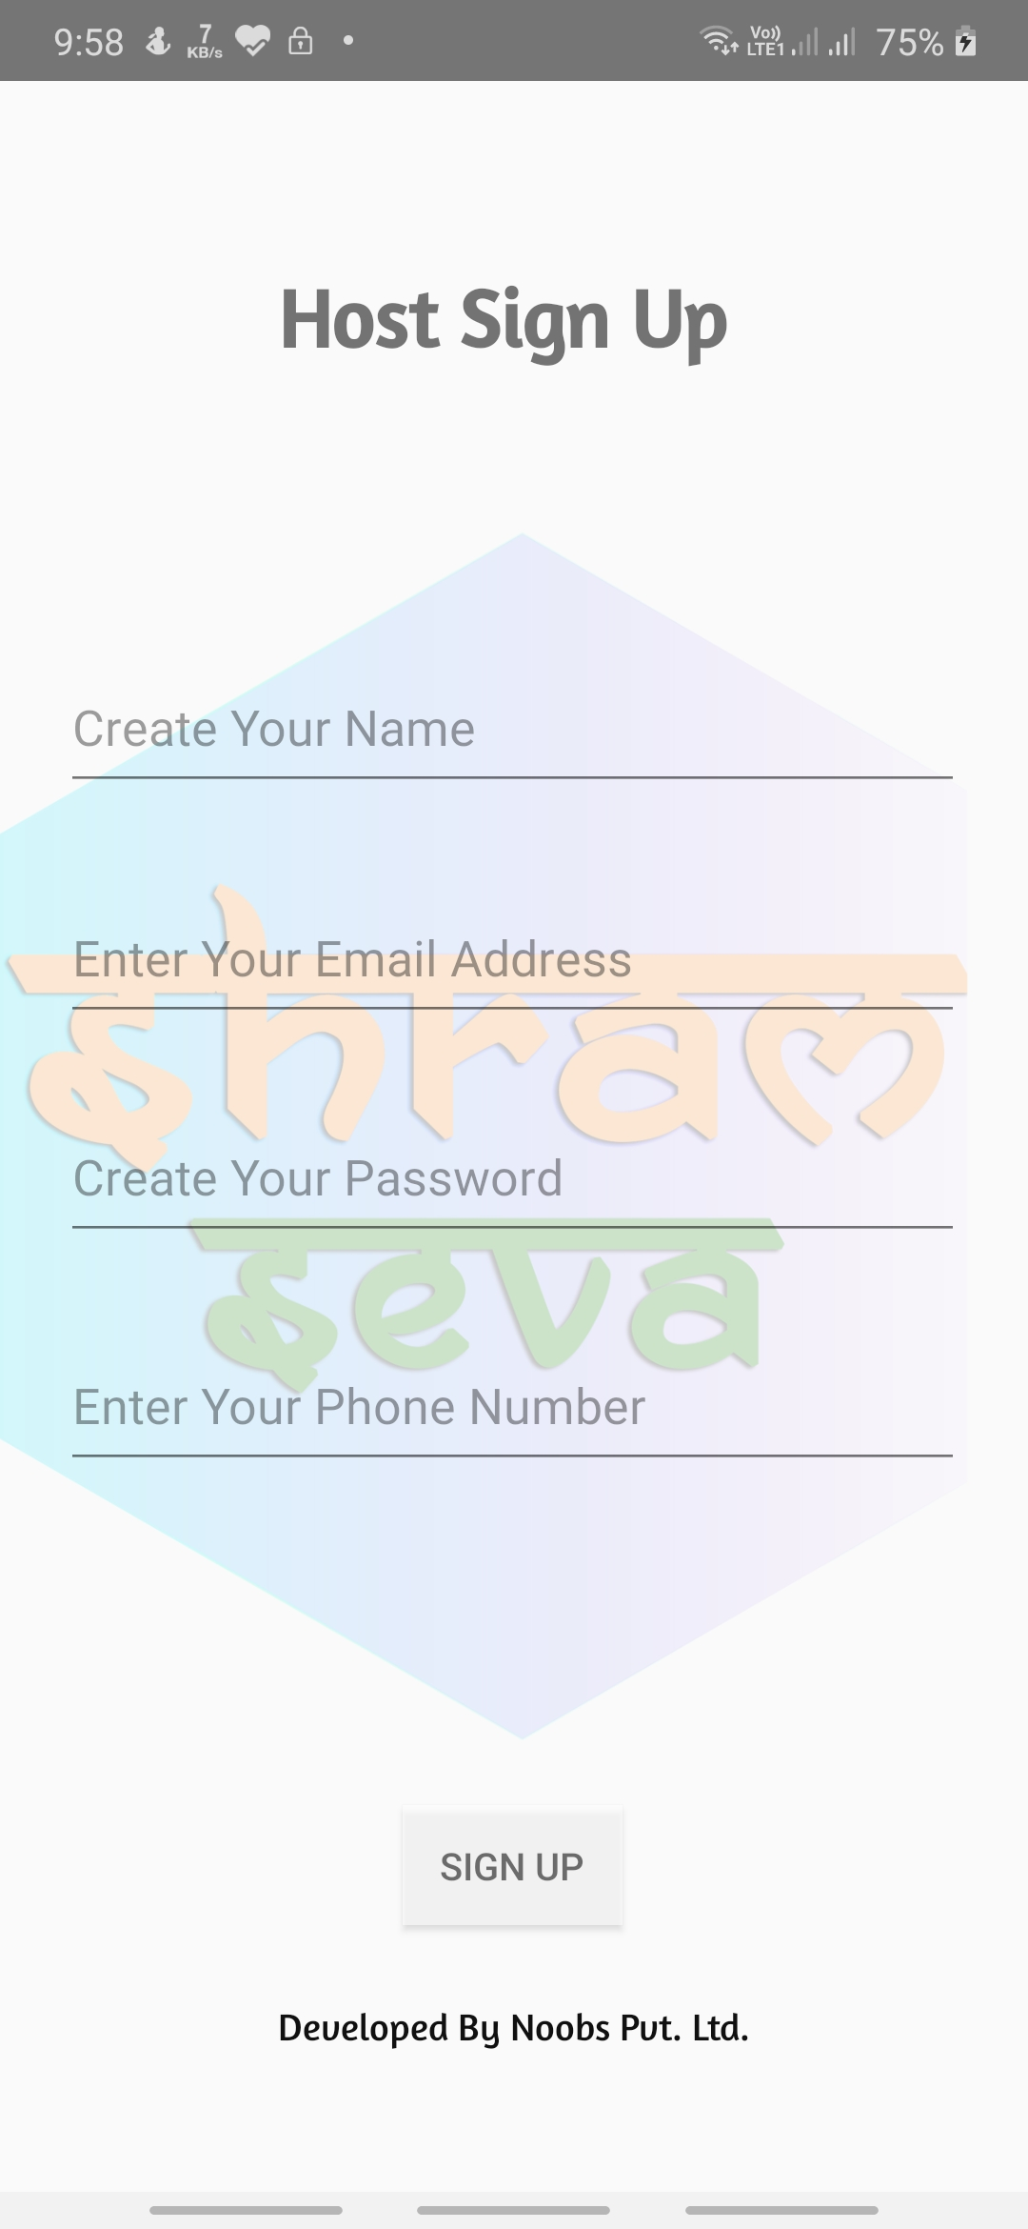
BY CLICKING HOST SIGN UP THIS PAGE WILL OPEN FOR CREATING NEW ACCOUNT
HERE HOST WILL ENTER NAME
HERE HOST WILL ENTER A VALID EMAIL ID
HERE HOST WILL CREATE A PASSWORD FOR HIS/HER ACCOUNT
HERE HOST WILL ENTER HIS/HER PHONE NUMBER
BY CLICKING SIGN UP BUTTON HOST WILL SUCCESSFULLY SIGNED IN HIS/HER NEW ACCOUNT

Slide 20
THIS PAGE IS FOR DONATION UNDER DONATION BUTTON IN APP
BY CLICKING A NEW PAYMENT PAGE WILL OPEN
HERE THE DONOR WILL WRITE NAME
WILL WRITE CITY
WILL SELECT DATE OF BIRTH
WILL CHOOSE PAYMENT MODE
BY CLICKING PAYMENT PAGE WILL OPEN

Slide 21
BY CLICKING DONATE NOW PAYMENT GATEWAY WILL OPEN THIS IS FOR THOSE WHO WANT TO HIDE THERE NAME AS A DONOR
HERE CARDHOLDER WILL ENTER NAME
HERE CARDNUMBER WILL BE ENTERED
HERE CARDHOLDER WILL ENTER CARD EXPIRY DATE
HERE CVC WILL BE ENTERED
BY CLICKING IT A PAYMENT LINKED TO BANK WILL BE OPENED

Slide 22
WE HAVE FOUR PAYMENT MODES

Slide 23
THIS IS THE ENQUIRY FORM ANYONE HAVING ANY ENQUIRY CAN REGISTER HERE
HERE NAME OF THE PERSON WILL NE ENTERED
WILL SELECT DATE OF BIRTH
WILL WRITE A VALID EMAIL ID
WILL ENTER QUERY IN DETAIL
AFTER CLICKING SUBMIT BUTTON THE QUERY WILL BE SEND TO HIS EMAIL AND OUR TEAM WILL REPLY THROUGH MAIL

Slide 24
Business Model
Size of the problem:
Lots of people from Uttar Pradesh and Bihar are migrated to Maharastra,Gujarat,Delhi for employement purpose.
In which many worker work on daily wages that means they do not earn enough for saving or any emergency circumstances.
There are many states whose members migrated to other states just for empoyement purpose.
Here we understand our problem with the database of migrants of UP and Bihar as they are more in number.
UP and Bihar containing 350 million population.Youth villagers of these states usually migrates.
Due to corona pandemic and lockdown situation about 180,000 worker returned back to Bihar out of which 27,000 are in quarantine center since 15 april according to BBC news.
Similar conditon with UP daily wages workers.
Workers in quarantine are escaping due to lack of facilities ,money and awareness.

Slide 25
Market for application
With the above data we can clearly see the number of problems arising due to migrants like
Lack of quarantine center.
Lack of facilities in the the quarantine center.
Lack of awareness.
We basically work on these problem to setup a market for our application with the help of our government.
Qurantine centers: We suggest places like rooms,schools,farming land etc to government for making more centers with cheap rates and better facilities.
Facilities:We provide data to government that show the updates of facilities like food,water supply,electricity etc of every quarantine center.
Awareness:We will give new ideas to volunteers for spreading the awareness.
With these basic things we aquire a great market.

Slide 26
Investement on the project
We are using website and and android app parallerly.
Website gives us higher reach,compatibility and are cheap.
Mobile app gives us better speed,better data encryption.
Taking care of safety,speed,cost effectivity and better performance we created this project.
Links are used for connecting app with website.
For better understanding ,we had estimated a figure ie about 3 lakh donator and about 40,000 official will run this application so the total investement on the project will be:
$25 for registration on google playstore, $200 for purchasing all the domains(.co,.in etc),$75 for application and webpage maintenance.
$300 ie 22,800 rupees will be invested for complete project.
NOTE: If in future we want to increase our user capacity , additional charges will be included but the charges will not effect the the investment much .

Slide 27
Money for Running the project
Their is 2 source of money:
Public donation.
Government funds.
Public donation:
Public will play a major role in this project.
As I mentioned we will understand this point with above assumption of 3 lakh people's investement.
In this 3 lakh people, many will donate grains,mask,safety kit,money etc. as in our application donator can donate anything what they have.
suppose an average person donates 50 rupees then there will be 1.5 crore rupees.
If some businessman,cricketers,filmstars or any big personality will donate then Easily it will be above 5 crore.
So if we will be able to increase our reach our rate of getting money will also increase.

Slide 28
Government funds:
As our Indian GDP is on downfall so we do not expect government to give big amout for these labours as they have to spend the money in otherfield.
Indian government recently get lots of money in their PM care fund. We can demand money from that.
State government will also fund in this.
If money will not be collected as on large scale then these government funds will be a backup.
Presence of government will ensure that application is not making any fraud.

Slide 29
Market Competitors Strategy
Our application has envolvement of State government,Central government and private sectors which makes our application trusted for Indian.
Provide transparency.
Ensures safety.
Cheap and well work performance.
Emotional quotes in the application to boost the user energy.
Providing features to donate in different manners(money,grains,mask,food etc)
Easy to use application.
Algorithim which continuosly updates the volunteer.
Easy to contact in heirchy of officials.
Giving suggestion welcome environment.

Slide 30
THANK YOU

